Slide 1



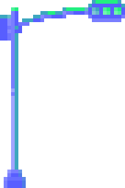



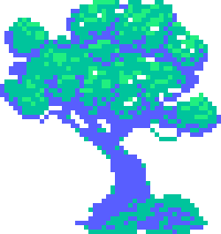


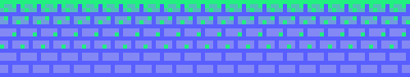
1. OYUNCU
YÜKSEK PUAN 2500
2. OYUNCU
EDERIŞ:GOK-KAL
Mehmet Semih Aslan-Cansu Şahin

Slide 2
1. OYUNCU
YÜKSEK PUAN 2500
2. OYUNCU
GENERAL INTRODUCTION OF THE GAME
Our game is a 3D isometric action game that incorporates rogue-like elements.
The game consists of floors that need to be cleared in order to ascend to the layers of the heavens. Since we must eliminate all enemies on a floor to progress to the next, the core dynamic of this game can be described as "Destruction."
If we were to classify the player base within Bartle’s Taxonomy, we could predominantly categorize them as "Killers."

Slide 3
1. OYUNCU
YÜKSEK PUAN 2500
2. OYUNCU
STORY OF THE GAME
The goal of the game is to ascend through the layers of the sky and reach Kayra Han, the god of the heavens, to ask about the meaning of human life.
Our main character has grown weary of the suffering in life and wishes to ask their creator why they were brought into existence. There is only one way to ascend to the heavens—making a pact with Erlik. While climbing the layers of the sky, the character interacts with the gods they encounter, seeking to understand their perspectives on life. Throughout the journey, they continue to question their purpose.

Slide 4
1. OYUNCU
YÜKSEK PUAN 2500
2. OYUNCU
DESIGN IDEA
The core challenge of the game lies in discovering the enemy types and difficulty levels within the layers of the sky. This multilayered structure, enhanced with a mythological theme, provides players with a constant sense of progression. The players' goal is to complete the layers and uncover the meaning of life.
Although the variety of enemy types is not as extensive as initially planned, each enemy possesses unique characteristics. Mythological themes are combined with psychological elements to deliver a deep narrative and compelling character development.

Slide 5
1. OYUNCU
YÜKSEK PUAN 2500
2. OYUNCU
STRENGTHS OF THE GAME
If we were to highlight the strengths the game aims to reflect:
Atmosphere and Narrative Technique
Map Designs
Story
Fast-Paced Gameplay
Character Interactions
Voice Acting Support

Slide 6

1. OYUNCU
YÜKSEK PUAN 2500
2. OYUNCU
TRAILER

Slide 7
THANK YOU FOR LISTENING.

Slide 8
1. OYUNCU
2. OYUNCU
GITHUB LINK: HTTPS://GITHUB.COM/SEMIHASLN/TURK-MYTHOLOGY

